Slide 1
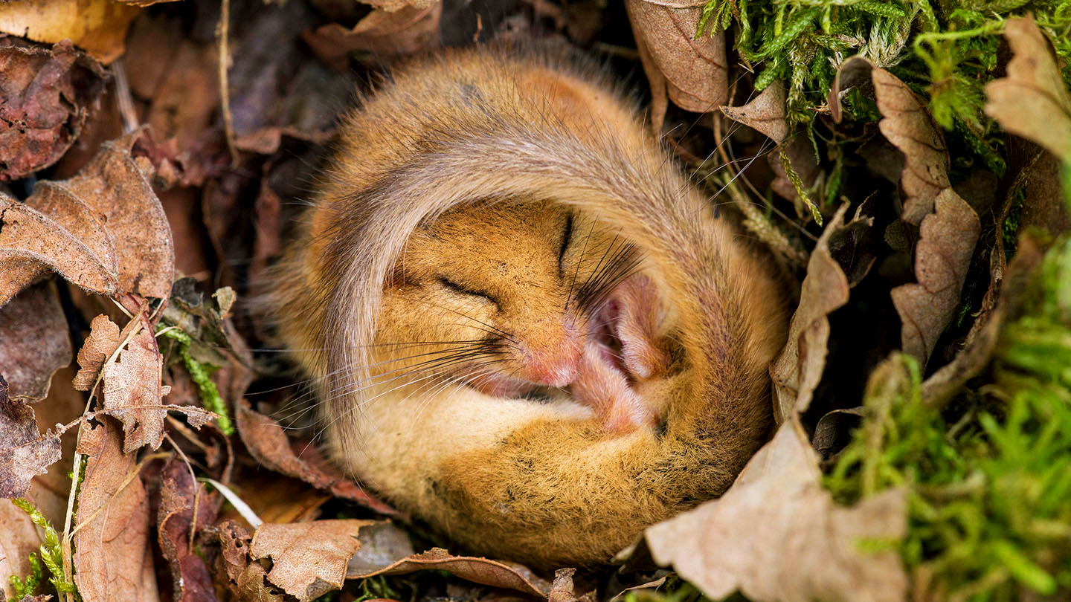

Slide 2

What actually are dormice?
Why should I care about dormice?

Slide 3
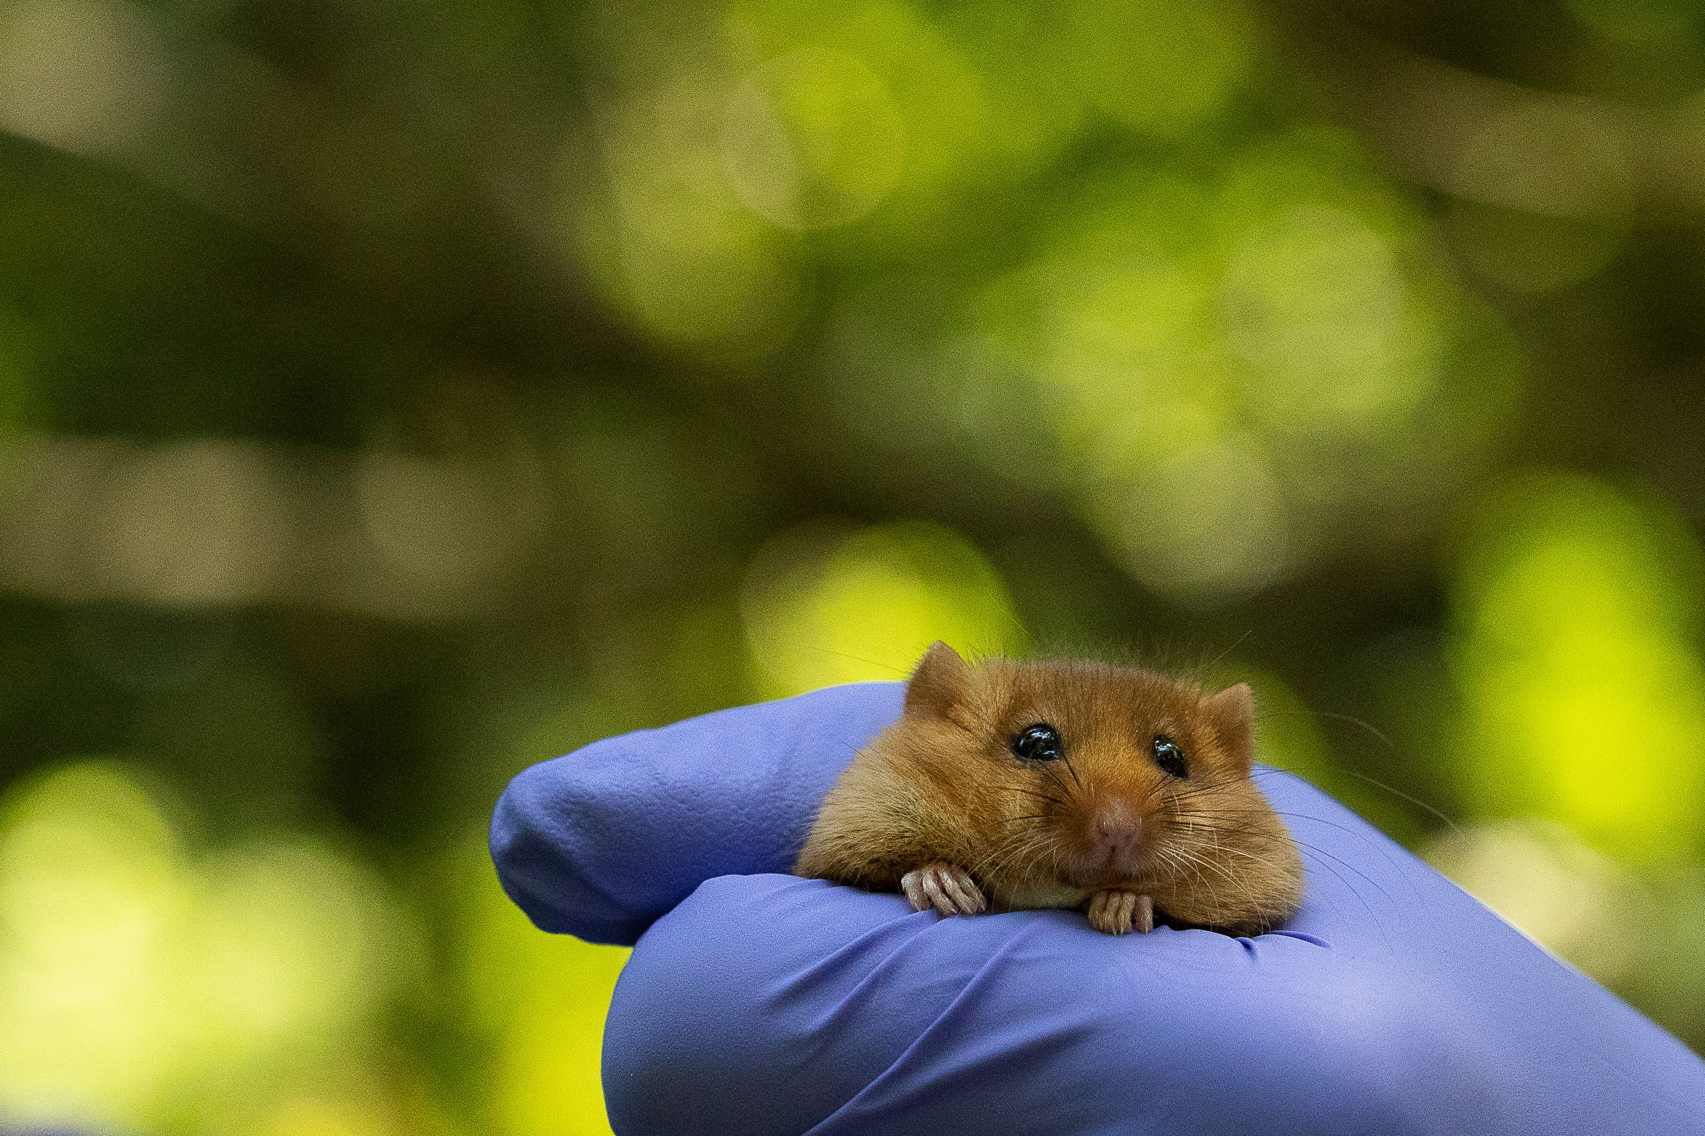
(Jazz explains)
The National Dormouse Monitoring Project
Jazz dormouse reintroduction site

Slide 4











Slide 5
























Slide 6


























